Slide 1


Sponsorship Information
2017

Slide 2
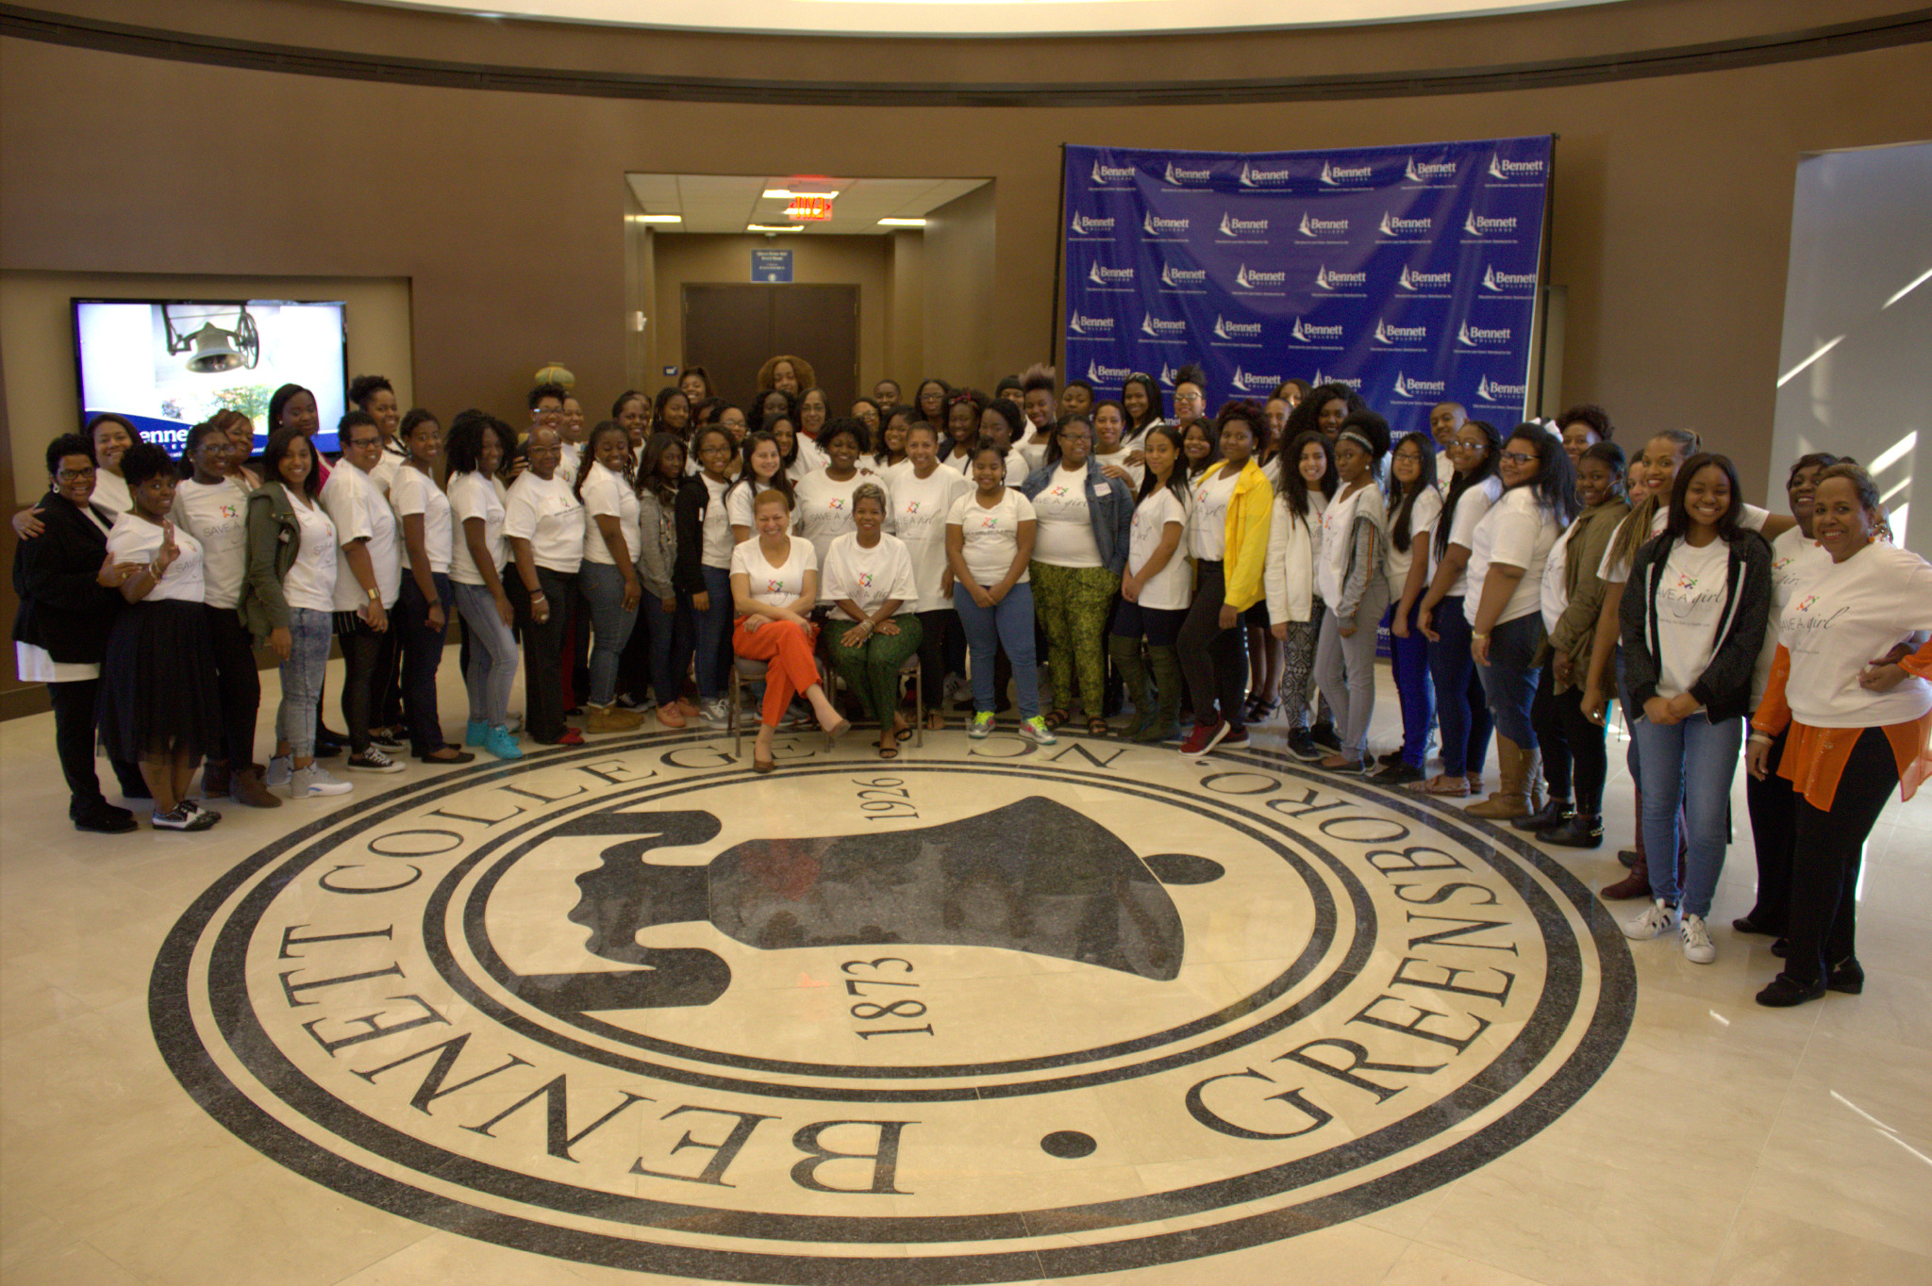
Since 2011, SAGSAW has
Mentored over
200
College and
High School
Female Students
Forged relationships with HBCU’s and over
200
professional women and entrepreneurs from across the country

Slide 3

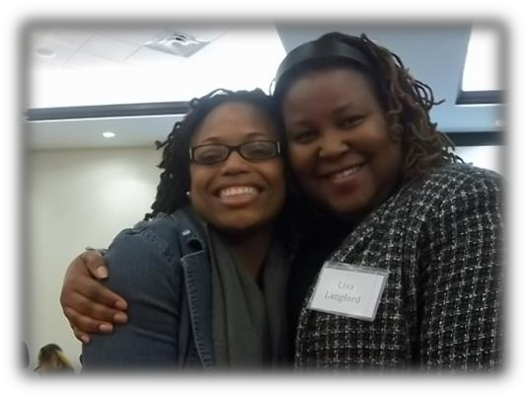
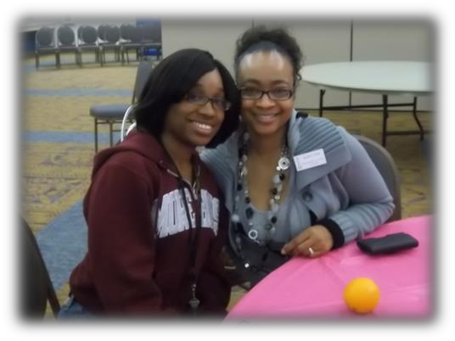
Our Mission
Save a Girl, Save a World (SAGSAW) is a 501(c)3 non-profit organization that provides multi-generational mentoring and self-esteem building programs conjunction with Historically Black Colleges and Universities (HBCU’s) for the purpose of assisting young girls and young women with a continued pipeline of support through mentorship.
Together, SAGSAW assembled its professional resources along with its network of some of the brightest and most accomplished women from coast to coast to work as mentors. The program is designed around specific lifestyle ppillars to engage mentees and assist them in exploring simple ways to gain focus and address real life situations with a positive outlook.

Slide 4
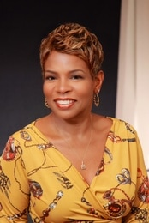
Pillars We Stand On
Wealth Creation through Financial Education
We build the financial acumen of young women to prepare them to successfully manage their finances to create a legacy for themselves and their families.
Life Skills
We provide learning opportunities to instill a firm foundation through which growth can occur.
Career Development
We introduce mentor-shaping experiences to encourage young women to pursue their dreams.
Health and Wellness
We encourage a strong body, mind and spirit to build self esteem and confidence.
Glenda Gill
Founder and CEO
Save A Girl, Save A World

Slide 5
What We Do
We ensure that young women are equipped with a healthy self-image to contribute to social importance and personal development.
We instill self confidence, life skills and new experiences to contribute to society in a life-changing way.
We promote academic achievement through programs, conversations and one-on-one interactions.
We provide mentors across diverse disciplines aligned to resources, industries and experiences to help young women develop goals and ideas to have a global impact.
We engage young women in financial literacy to foster healthy consumerism and spending habits.

Slide 6
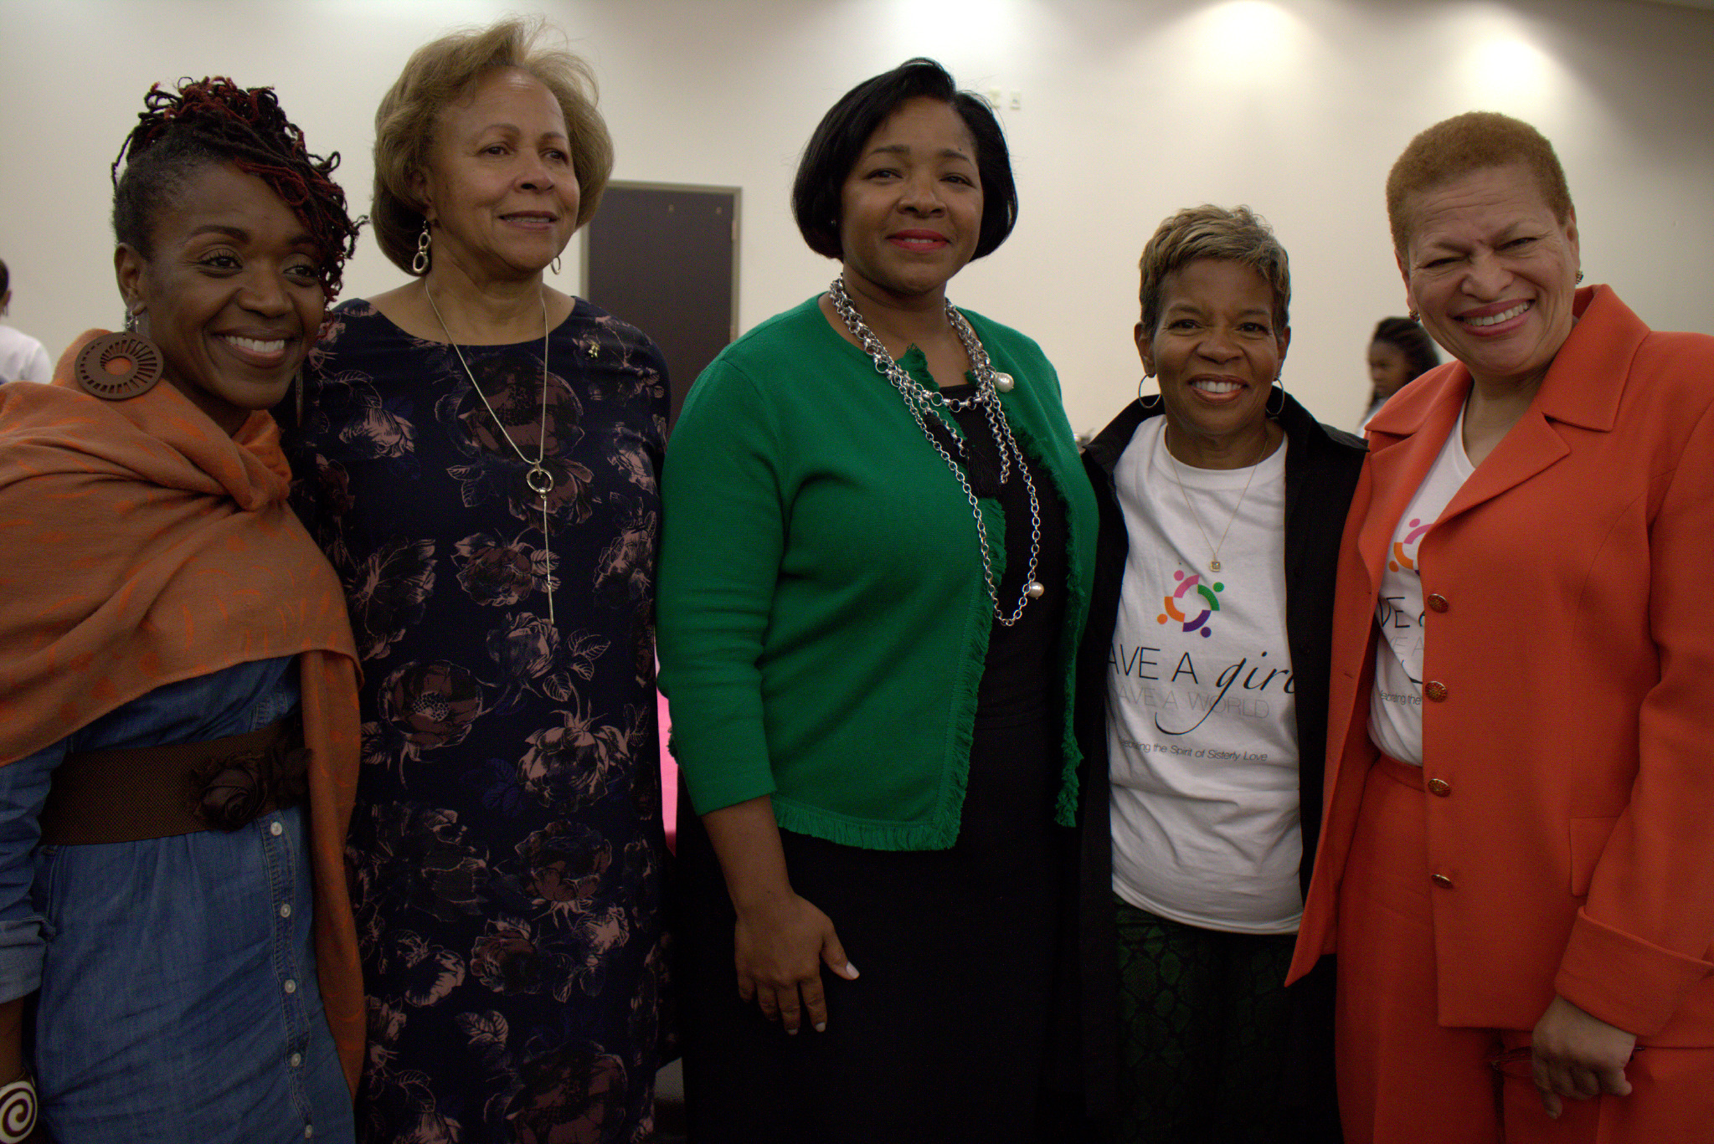
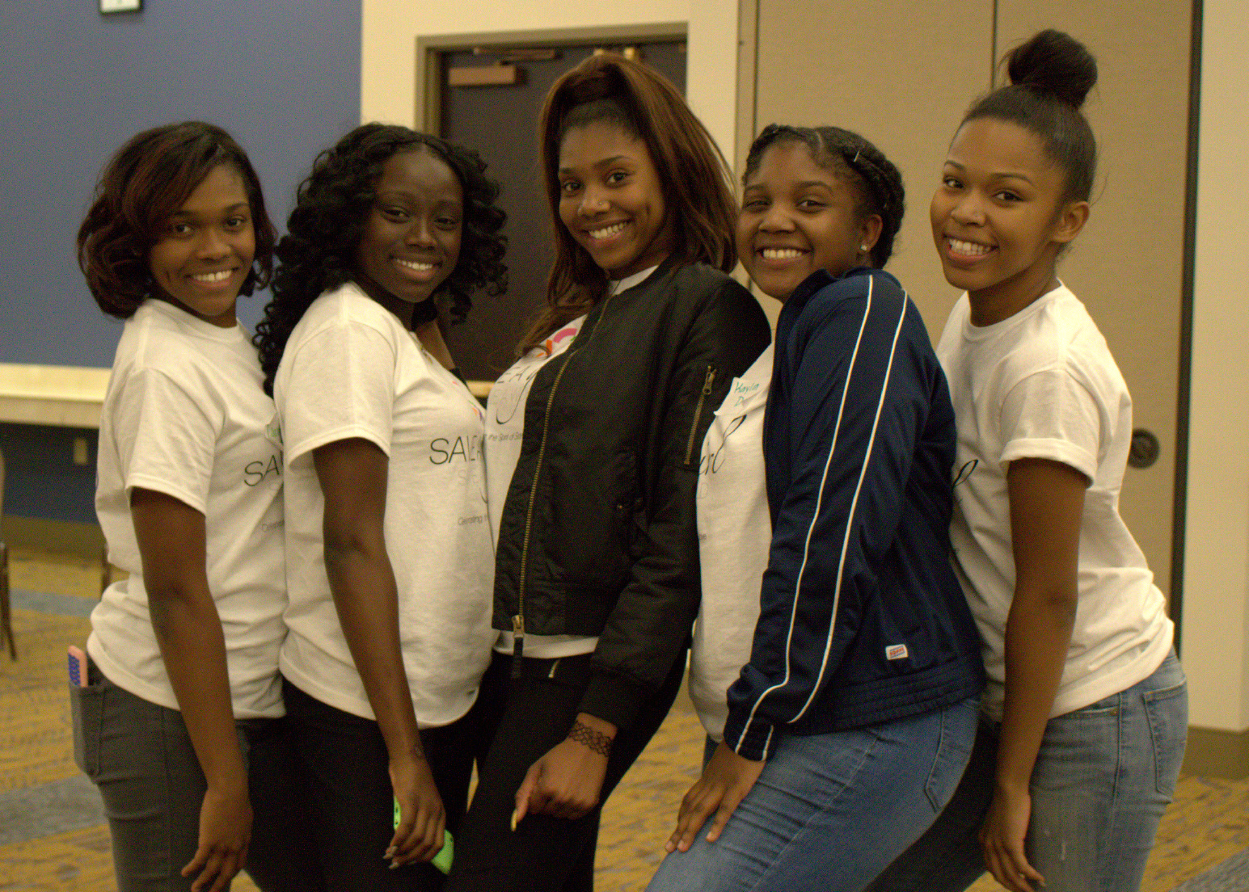
Mentor Program Snapshot
35 PROFESSIONAL LEADERS
Includes all levels of professional women covering various work disciplines, women business owners and national women’s organizations
35 COLLEGE/UNIVERSITY STUDENTS
Includes collegiate female students from HBCU universities and colleges. This year we are working with female students from Clark Atlanta University and Bennett College.
35 HIGH SCHOOL STUDENTS
Includes high school female students from schools that are associated with the HBCU collegiate relationships

Slide 7
Our Core Programs
Save A Girl, Save A World Annual Weekend Retreat -– An annual weekend event that involves an “arms around” environment where targeted participants are triad-paired with professional women, college students and high school students for a three-day summit. Workshops that foster growth and bonding are conducted throughout the weekend covering topics related to the four pillars: wealth building, healthy living, career, and goal setting.
College Ambassador Program -This program consists of college students who are involved in providing services, programs and activities that are available to help middle and high school students’ classroom experience, facilitate their personal and academic growth and address the needs of the student.
SAGSAW Webinar Series -The SAGSAW Webinar Series is a three-month series of webinars. Each webinar will cover a specific topic (i.e. Financial Literacy, Creating Your Brand, and Political Activism). The one-hour webinars will allow the opportunity for the mentees to not only learn necessary skills within the various topics, but will also allow them to interact, ask questions, and walk-away with assignments that will assist them in applying what they have learned. By taking part in the webinars and completing the various assignments the mentees will also gain eligibility to win prizes at the Annual SAGSAW Retreat.

Slide 8
SAGSAW Program Activities
JANUARY | High School Mentee/Mentor Educational Activity and Board Meeting
FEBRUARY | Executive Committee Meeting
MARCH | CIAA Event – Collegiate Educational Activity and Mentee Reconnect using Technology (ongoing), and Fundraising
APRIL | Program Development, World of Money – Financial Literacy, C-STEM Partnerships (ongoing), and Board Call
MAY | C-STEM Competition
JUNE | Program Development, Prospect research, Students Abroad
JULY | Mentor/Mentee Reconnect using Technology
AUGUST | Professional Mentors Training and Marketing, Follow-ups and Quarterly Newsletter, and Board
SEPTEMBER | Program Development
OCTOBER | Annual Weekend Retreat preparations
NOVEMBER | Annual Weekend Retreat/SAGSAW Board Meeting
DECEMBER | Post Weekend Retreat and End of Year Newsletter

Slide 9
Our Core Partnerships

Slide 10

Core Partnership Program
WORLD OF MONEY/SAGSAW Partnership
World of Money (WOM) allows Save A Girl, Save A World to provide students with financial literacy education via on-site learning, webinars and other content. A unique centerpiece of the program is the World of Money app. Our mutual goal is to make students masters of basic money management. Founded in 2005 by Sabrina Lamb, WOM features a curriculum that includes basic financial tools for youth; how to budget, save and invest; how to use financial technology; innovative thinking; how our government works; and foreign language, culture, and travel. The content also encompasses managing loans, paying for college, understanding budgets, credit cards, 401(k)s, payroll taxes and investments. More than 4,000 parents and their children have successfully completed the WOM program.
2017 SAGSAW Wealth Creation Highlight: SAGSAW representatives attended the Berkshire Hathaway Shareholders meeting in Omaha, Nebraska on May 6, 2017. Participation in this wonderful opportunity offered through Gail Perry Mason, Money Matters for Youth Camp, allowed attendees to recognize a world of opportunities and gained valuable knowledge that they can incorporate in their lives and communities.

Slide 11

Core Partnership Program
C-STEM/SAGSAW Partnership
Our mutual goal is to provide the tools that empower students to become innovators and technologically-proficient problem solvers. Through mentoring, coaching and training, we want to introduce young women to the vast array of educational and career opportunities in STEM fields. Founded in 2002 by Dr. Reagan Flowers, C-Stem Teacher & Student Support Services is designed to close the achievement gap by helping students learn and experience communication, science, technology, engineering, and mathematics through innovation that exposes these concepts through a myriad of disciplines. These include robotics, geoscience, 3D printing, film making, photography, sculpture, mural, creative writing and photography.
2017 Highlight: C-STEM Teacher & Student Support Services, Inc. (C-STEM), hosted the National CSTEM Challenge on Saturday, May 20, 2017 at The Health Museum in Houston, Texas. We're proud of our SAGSAW students who participated along with nearly one-thousand students and 26 schools in this year's event. Teams competed in robotics, innovation, computer programming, art, film, photography, mural, sculpture and debate.

Slide 12
Core Partnership Program
Dreamwalking Partnership
Dreamwalking is a powerful program that helps participants move their DREAMS from their HEART to their HEAD, to their HANDS and ultimately to their FEET, where they are walking in their purpose and designing their destiny.
Sonya Jackson Myles, knows that with 50% of the workforce now female, it is essential for any corporate entity or organization to begin ensuring that women are fostering healthy productive relationships as early as possible. Cultures that do not reinforce this mindset will experience a negative impact on productivity and profitability. This offering shares insights and provides skills and tools for females to build positive relationships personally and professionally by nurturing the intrinsic value of womanhood while preparing for life after college.

Slide 13
Save A Girl, Save A World Weekend Retreat
“Transformation = Passion”
November 2-5, 2017
Clark-Atlanta University – Atlanta, GA
Sponsorship Opportunities

Slide 14
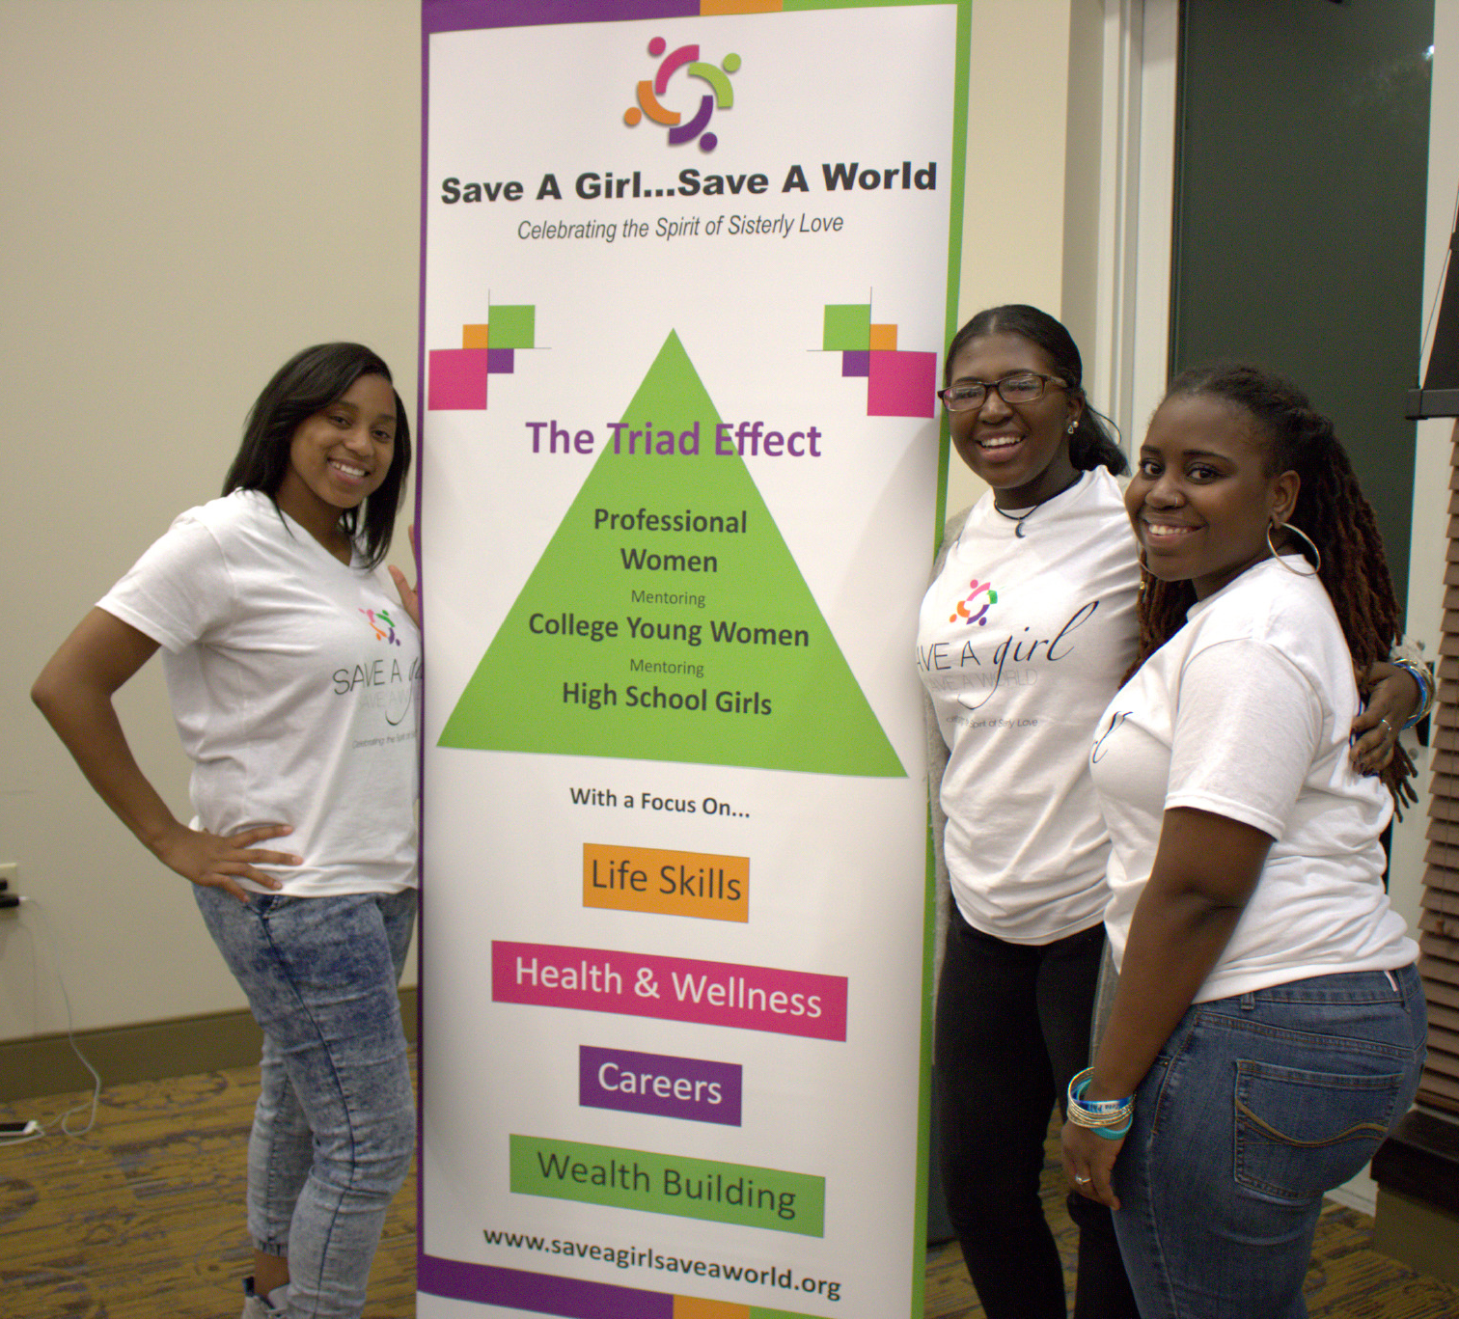
SAGSAW Annual Weekend Retreat
Nov. 2-5, 2017 - Clark Atlanta University, Atlanta, GA
Gold Sponsor - $35,000
Three-day weekend retreat to be held at includes: workshops, speakers, sessions, activities and leadership facilitation. Sponsorship includes:
Brief remarks at premium selected event activity
Company logo placement on all marketing materials
Full-page ad in program booklet (premium placement)
Conference bag with prominent company logo placement on bag
Promotional item in the weekend retreat conference bag
Year-long company logo placement on SAGSAW Website
One (1) article is the SAGSAW IMatter Newsletter
Company logo printed on conference T-shirt
Company name included on press materials
Company specific inclusion in SAGSAW social media engagement

Slide 15
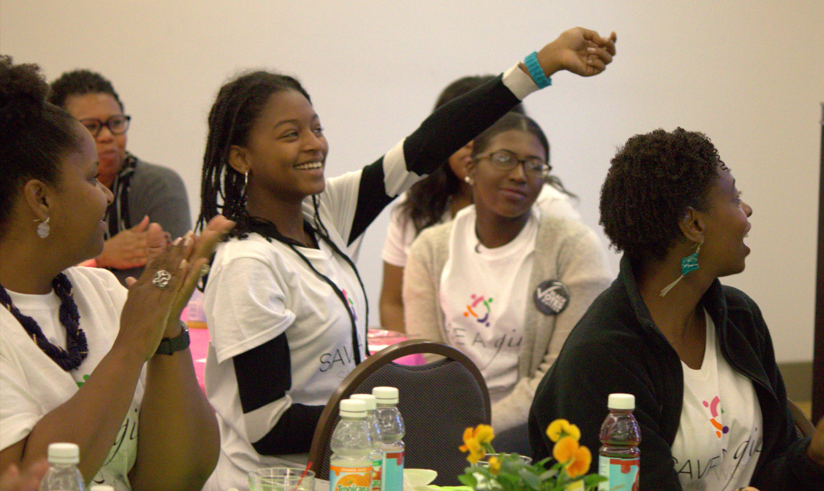
SAGSAW Annual Weekend Retreat
Nov. 2-5, 2017 - Clark Atlanta University, Atlanta, GA
Silver Sponsor - $25,000
Three-day weekend retreat includes: educational workshops, speaker sessions, relaxation activities, leadership facilitation and meals. Sponsorship includes:
Brief remarks at premium selected event activity
Company logo placement on all marketing materials
Full-page ad in program booklet (inside placement)
Promotional marketing item in weekend retreat conference bag
Conference bag with prominent company logo placement on bag
6-month company logo placement on SAGSAW Website
One (1) article is the SAGSAW IMatter Newsletter
Company logo printed on conference T-shirt
Company name included on press materials
Company specific article on SAGSAW social media engagement

Slide 16
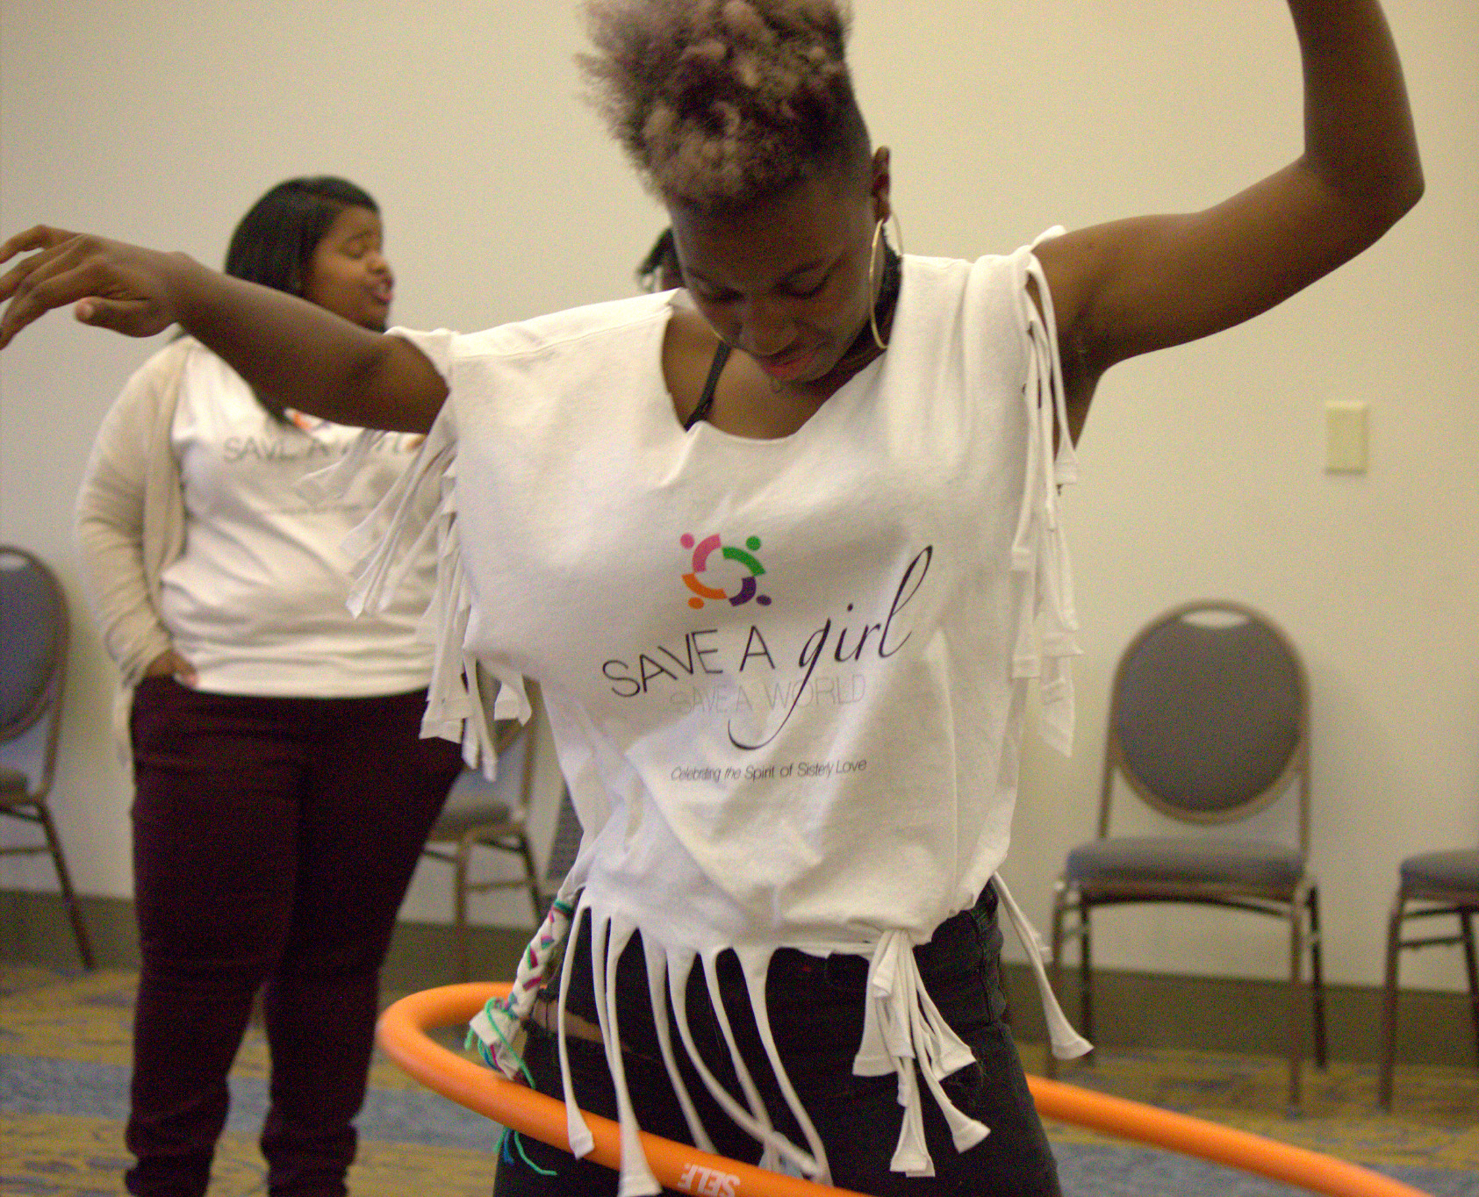
SAGSAW Annual Weekend Retreat
Nov. 2-5, 2017 - Clark Atlanta University, Atlanta, GA
Bronze Sponsor - $15,000
Three-day weekend retreat includes: educational workshops, speaker sessions, relaxation activities, leadership facilitation and meals. Sponsorship includes:
Company logo placement on all marketing materials
Company name listed in program booklet
Promotional material in the weekend retreat conference bag
Conference bag with prominent company logo placement on bag
3-month company logo placement on SAGSAW Website
Company logo printed on conference T-shirt
Company mention on SAGSAW social media engagement

Slide 17
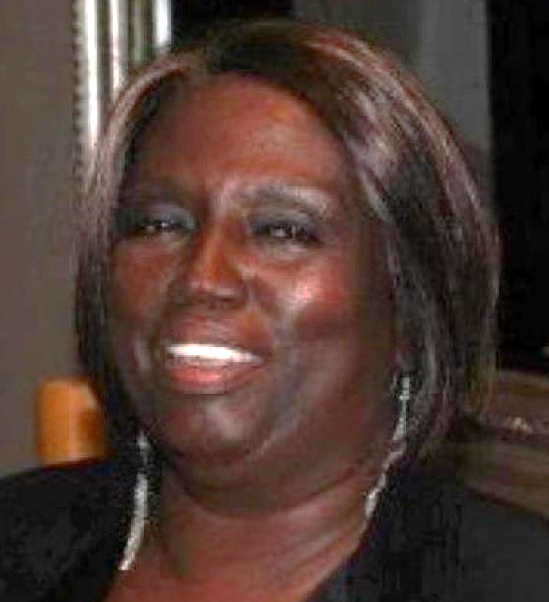
Scholarship and Educational Assistance – $10,000 to $25,000
Kathleen Lynn Marie Wilkes SAGSAW Scholarship Award
Save A Girl, Save A World offers the Kathleen Lynn Marie Wilkes Save A Girl, Save A World Scholarship. The scholarship is awarded to students who participate in the program that achieve academic success and/or on a need-bases who play an active role in their communities. The goal of the program is to develop leadership potential, encourage a spirit of social justice and advocate for social change. Award amounts ranging from $1,000 – $2500 will be given to the winning candidates.
About Kathleen Lynn Marie Wilkes
“Kathi Wilkes” set the standard for seasoned and consummate professionals. Her professional career included being a registered nurse, professor, practicing attorney, a government relations & business consultant, Capitol Hill chief of staff, senior policy advisor and a lobbyist. Kathi was a woman of many triumphs who had a great fondness for young people. She was an adventurous entrepreneur and was equipped to climb the highest mountains and obtain the greatest achievements.
Two of her many accomplishments included raising over $16 million for the historic Martin Luther King, Jr. Memorial and working with Congresswoman Sheila Jackson Lee to secure substantial funding for the Sojourner Truth bust, which is placed in the Capitol rotunda. Kathi was a servant, leader and mentor to many staffers on Capitol Hill, where she was an advisor to many Congressional Black Caucus members over the years. She was a dedicated member of the National Coalition on Black Civic Participation- Black Women’s Roundtable and served as a founding board member for Save a Girl, Save A World mentoring program. She had a “true” passion for mentorship, politics and was actively involved in community advocacy.

Slide 18
SAGSAW Annual Weekend Retreat
VIP & Community Leader Reception - $10,000
The Three-day weekend retreat to be held at Clark Atlanta University will kick-off the weekend activities with a invitational-only VIP Reception to be held at Clark Atlanta University’s Art Museum. Attendees will include women community and organizational leaders from Atlanta, SAGSAW Board Members, and SAGSAW professional women mentors. Sponsorship includes:
Brief executive remarks at VIP & Community Leader Reception
Company signage at event
Gift item for VIP Reception attendees
½-page company ad in retreat program booklet
Product marketing material in the weekend retreat conference bag
Sponsor logo on SAGSAW Website

Slide 19
SAGSAW Annual Weekend Retreat
Student Pitch Competition Sponsor - $10,000
Three-day weekend retreat to be held at Clark Atlanta University will include a pitch competition from the campus and SAGSAW student participants. Monetary prizes will be given away at the event. Sponsorship includes:
Brief remarks at SAGSAW Pitch Competition
(1) Executive to serve as judge for the Pitch Competition
Company name listed in weekend retreat program booklet
Product marketing material in the giveaway bag
Sponsor logo on SAGSAW Website
Company name mention from event on SAGSAW social media engagement

Slide 20
SAGSAW Core Partnership & Additional
Sponsorship Opportunities

Slide 21
SAGSAW Webinar Series
SAWSAG Webinar Sponsor - $5,000
SAGSAW Webinar Series is a three-month activity that consist of web-based seminars, presentations, lectures, discussions or focus groups.
The webinar topics support the SAGSAW four pillars: Wealth, Life Skills, Career Development and Health & Wellness. The one-hour sessions allow mentees to learn and have discussions about lessons learned from each informative session.
Company branding on the all webinar series
(1) speaker or focus group discussion on topics that relate to the SAGSAW four pillar
Opportunity to be a webinar presenter during (1) session with students
Opportunity to be a webinar presenter during (1) session with the professional mentors

Slide 22
WORLD OF MONEY/SAGSAW Partnership Program
Sponsorship Opportunity: $25,000
The World of Money-SAGSAW programming partnership allows SAGSAW to provide students with content of financial literacy education via on-site learning, webinars and WOM mobile app. Our mutual goal is to make students masters of basic money management.

Slide 23
C-STEM/SAGSAW Partnership Program
Sponsorship Opportunity: $25,000
Through mentoring, coaching and training, SAWSAW introduces young women to the vast array of educational and career opportunities in STEM fields. Our goal is to help students gain knowledge on a myriad of disciplines related to science, technology, engineering and mathematics.

Slide 24
Dreamwalking and SAGSAW Partnership
Sponsorship Opportunity: $25,000
Sponsor of Vision Board Session and Presenting Opening Speaker of Dreamwalking Course led by Sonia Jackson-Myles (keynote). This event is our opening session of the Retreat Weekend
​Facebook Live sponsor during the vision board session
Company logo on event signage
Sponsor full-page ad in Program Booklet (prominent position)
Sponsor mention included in all press materials
Dreamwalking Column in SAGSAW I-Matter Newsletter
Post Event - Students to Journey their Dreamwalking experience on Facebook Live- Quarterly
Product promotional materials for weekend retreat conference bag
Company logo on SAGSAW’s website

Slide 25
For more information and sponsorship commitment letter, please contact:
Glenda Gill, Founder
www.saveagirlsaveaworld.org
ggsagsaw@gmail.com
313-657-5485

